Slide 1
Object Oriented Programming Part 3: Overloading
By: Ryan Alterman
Revised: 10-25-17

Slide 2
What is Overloading?
It allows you to specify multiple definitions of the same:
Function
Operator
Declaration of Overloaded statements
Happens in the same scope
Same name
Different definition / implementation
During runtime, the compiler will decide which overloaded function best fits the parameters given
This is overload resolution

Slide 3
Function Overloading
This allows us to create multiple definitions of the same function
The values inside the function MUST be different
You can not overload just by the change of return type!

Slide 4
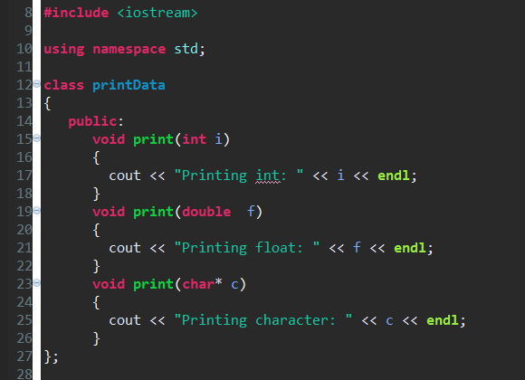
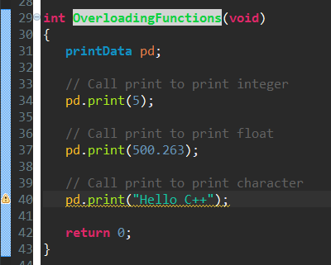
Overloading Functions

Slide 5
Operator Overloading
Most operators in C++ can be overloaded
This allows us to use operators for user defined types
They are like functions with a special name and keyword
The keyword is operator
They have return types and parameters like other functions
Operator Keyword
It is the operator keyword followed by the operator symbol you are overloading
Member and Non-Member declarations
If declared as Member of a Class:
You only have to set the parameter of what type it is looking for
If declared as a non-member:
You have to set the parameters for each object being manipulated

Slide 6
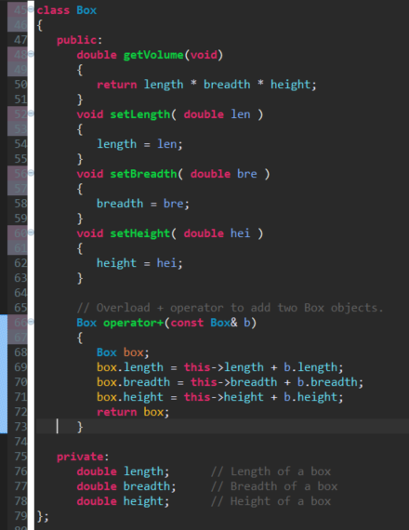
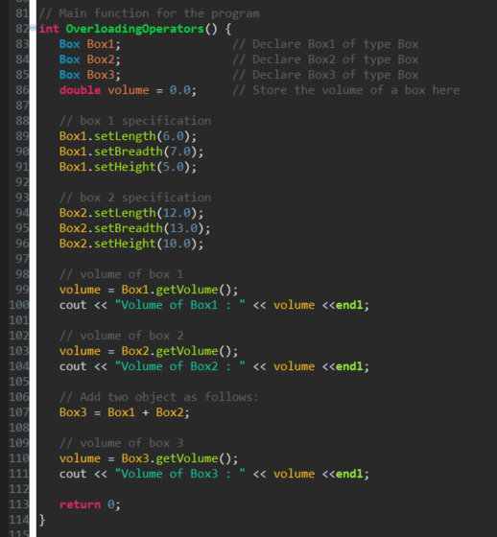
Overloading Operators

Slide 7
Overloadable Operators
Overloadable:
Non-Overloadable:
+ | - | * | / | % | ^
& | | | ~ | ! | , | =
< | > | <= | >= | ++ | --
<< | >> | == | != | && | ||
+= | -= | /= | %= | ^= | &=
|= | *= | <<= | >>= | [ ] | ( )
-> | =>* | new | New [ ] | delete | Delete [ ]
:: | .*
. | ?:

Slide 8
Challenge
When would we use these? Why? Now make an overloaded operator and function for a project that we are currently working on.

Slide 9
Next: Object Oriented Programming Part 4

